Slide 1
Digital Portfolio
STUDENT NAME: Naveetha M
REGISTER NO :24131210500122027
DEPARTMENT: BCA
NM ID :
COLLEGE: COLLEGE [Immaculate College For Women]
asanm121anm12124213027

Slide 2
PROJECT TITLE
This is my personal portfolio website where I introduce myself, showcase my skills and projects, and give people a way to connect with me. I built it using HTML, CSS, and JavaScript to keep it simple and clean.

Slide 3


AGENDA
Project Overview
End Users
Tools and Technologies
Portfolio design and Layout
Features and Functionality
Results and Screenshots
Problem Statement
Conclusion
Github Link
3/21/2024 Annual Review

Slide 4

PROBLEM STATEMENT
Students don’t have one place to show skills and projects .
Resume alone can’t highlight practical work .
Recruiters need quick access to projects and contact info.

Slide 5

PROJECT OVERVIEW
A personal portfolio website to showcase my skills and projects.
Built using HTML, CSS, and JavaScript.
Includes sections like About Me, Projects, and Contact.

Slide 6

WHO ARE THE END USERS?
The website is mainly for recruiters, teachers and anyone who wants to know about my work. It’s also useful for friends or peers who want to see my projects and get to know about me.

Slide 7

TOOLS AND TECHNIQUES
I created the site using HTML, CSS, and JavaScript. I worked in Visual Studio Code, used GitHub for version control.

Slide 8
POTFOLIO DESIGN AND LAYOUT
The design is straight forward. The header has my picture and a short intro. There’s a navigation bar that links to different sections – About Me, Projects, and Contact. I also added a dark mode option to make the UI look modern.
8

Slide 9
FEATURES AND FUNCTIONALITY
The site has a round profile photo, smooth scrolling between sections, and a button to send me an email directly. The dark mode toggle gives it a stylish feel, and over all the layout is easy to use.

Slide 10

RESULTS AND SCREENSHOTS
The portfolio works as expected and looks neat. All the sections are clear and user-friendly. I’ve added screenshots in the PPT to show how the header, about, projects, and contact parts look.
3/21/2024 Annual Review
10

Slide 11
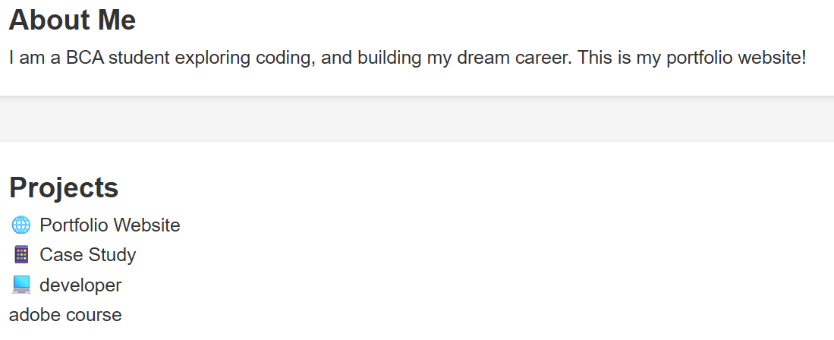

Slide 12
CONCLUSION
Through this project, I built a simple but functional portfolio that highlights who I am and what I do. It’s a starting point that I can expand later with more features like project cards, animations, or even a blog section.
12

Slide 13
Github link:
https://github.com/NaveethaManikandan/Naveetha-TNSDC-FWD-DP.git
13

